Slide 1
Markov Chains

Slide 2
Learning Objectives
To learn about Markov Chains and their various features
To become familiar with concepts of probabilistic states

Slide 3
Markov Chains
We briefly discussed Markov processes previously in the context of Gibbs Sampling and motif finding and how you can encode sequence data into Markov models
Markov Chain Monte Carlo
A Markov chain is a series of states that transition between each other and follow the Markov property such that the next state does not depend on the previous
A
A
B
A

Slide 4


Probability
Probability: the measure of the likelihood that an event will occur
Values range between 0 and 1
0 = event will never happen (0% chance)
1 = event will certainly happen (100% chance)
0.5 = 50% chance the event will happen
What is the probability of flipping a coin and getting heads?
1 in 2 or 0.5 (50%)
We would write this as P(A = heads) = 0.5
What is the probability of rolling a six sided die and getting a 3?
1 in 6 or 0.17 (17%)
We would write this as P(A = 3) = 0.17

Slide 5
Joint Probability
Joint Probability: the measure of the likelihood that two independent events will occur
Values range between 0 and 1
0 = both events will never happen (0% chance)
1 = both events will certainly happen (100% chance)
0.5 = 50% chance both events will happen
What is the probability of flipping a coin twice and getting heads twice?
For the first flip, A: 1 in 2 or 0.5
For the second flip, B: 1 in 2 or 0.5
P(A = heads) = 0.5
P(B = heads) = 0.5
If x and y are independent then we multiply 0.5 X 0.5 = 0.25
We would write this as P(A = heads, B = heads) = 0.25
What is the probability of rolling a six sided die twice and getting a 3 for the first roll and a 6 for the second roll?
P(A = 3) = 1/6 = 0.17
P(B = 6) = 1/6 = 0.17
Similarly two die roles we would write this as P(A = 3, B = 6) = 0.028

Slide 6
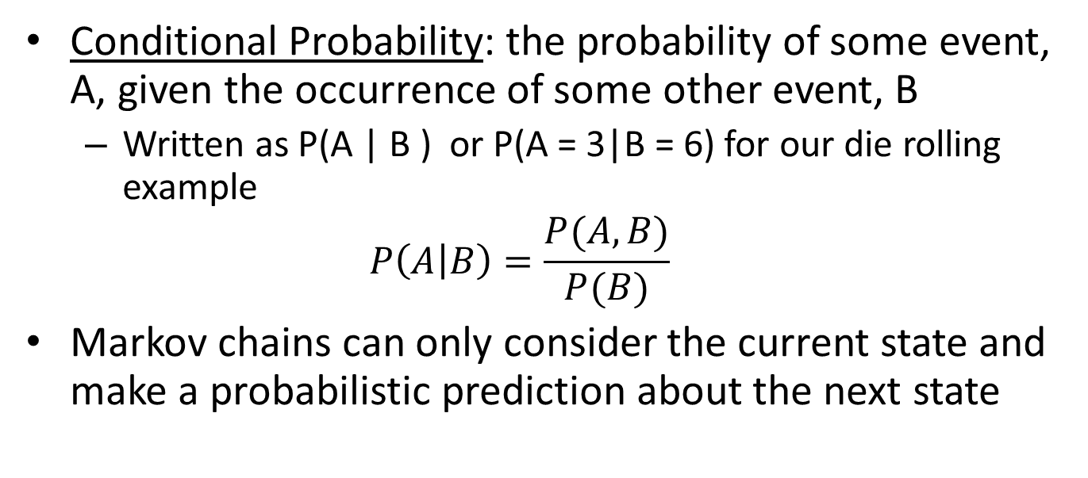
Markov Chains Use Conditional Probability
Conditional Probability: the probability of some event, A, given the occurrence of some other event, B
Written as P(A | B ) or P(A = 3|B = 6) for our die rolling example
$$P\left(A | B\right)=\frac{P(A,B)}{P(B)}$$
Markov chains can only consider the current state and make a probabilistic prediction about the next state
joint probability
marginal probability
A
0.3
T
0.25
G

Slide 7
Markov Chains Use Conditional Probability
Markov chain models can only consider the current state and make a probabilistic prediction about the next state
A Markov chain could be generated that would assign a probability of an A followed by a T:
P(B=T|A=A) = 0.3
Another model could be generated that would assign a probability of a T followed by a G:
P(B=G|A=T) = 0.25
If an ATG is observed in a sequence we can use this model to quantify the probability by using the same Multiplication Rule: P(B=T|A=A) X P(B=G|A=T) = 0.3 X 0.25 = 0.075
A
0.3
T
0.25
G

Slide 8
State Diagrams
State diagrams describe the possible transitions between states in our model
For example, if we are trying to model a DNA sequence we would need at least 4 states (A,T,C,G)
These states represent the current state (ACTG) and a probability of transitioning to the next (ACTG)
A
T
C
G
A Markov Chain for DNA

Slide 9
Markov Chain State Diagrams
Every arrow between states will have a probability associated with it
All probabilities from a given state should add up to one
If we wanted to describe the probability of observing a sequence we multiply probabilities together
For example to model the sequence AGTC we would calculate the following:
a_{AG}= P(G|A) = 0.25
a_{GT}= P(T|G) = 0.25
a_{TC}= P(C|T) = 0.25
P(AGTC) = a_{AG} X a_{GT} X a_{TC}
= 0.25 X 0.25 X 0.25
= 0.01562
0.25
0.25
0.25
A
T
0.25
0.25
0.25
0.25
0.25
0.25
0.25
0.25
0.25
C
G
0.25
0.25
0.25
A Markov Chain for DNA
0.25

Slide 10
Markov Chain State Diagrams
DNA State Diagram
One more detail…
We also need to model the probability of choosing the first base in our sequence
Conditional probabilities only describe transitions
Our sequence started with a particular base that occurred with a particular probability
β represents initial base selection with associated transition probabilities
0.25
0.25
0.25
A
T
0.25
0.25
0.25
0.25
0.25
0.25
0.25
0.25
0.25
C
G
0.25
0.25
0.25
0.25
0.25
0.25
0.25
0.25
β

Slide 11
Markov Chain State Diagrams
DNA State Diagram
Every arrow between states will have a probability associated with it
All probabilities from a given state should add up to one
If we wanted to describe the probability of observing a sequence we multiply probabilities together
For example to model the sequence AGTC we would calculate the following:
P(A) = 0.25
a_{AG}= P(G|A) = 0.25
a_{GT}= P(T|G) = 0.25
a_{TC}= P(C|T) = 0.25
P(AGTC) = P(A) X a_{AG} X a_{GT} X a_{TC}
= 0.25 X 0.25 X 0.25 X 0.25
= 0.00391
0.25
0.25
0.25
A
T
0.25
0.25
0.25
0.25
0.25
0.25
0.25
0.25
0.25
C
G
0.25
0.25
0.25
0.25
0.25
0.25
0.25
0.25
0.25
0.25
β

Slide 12
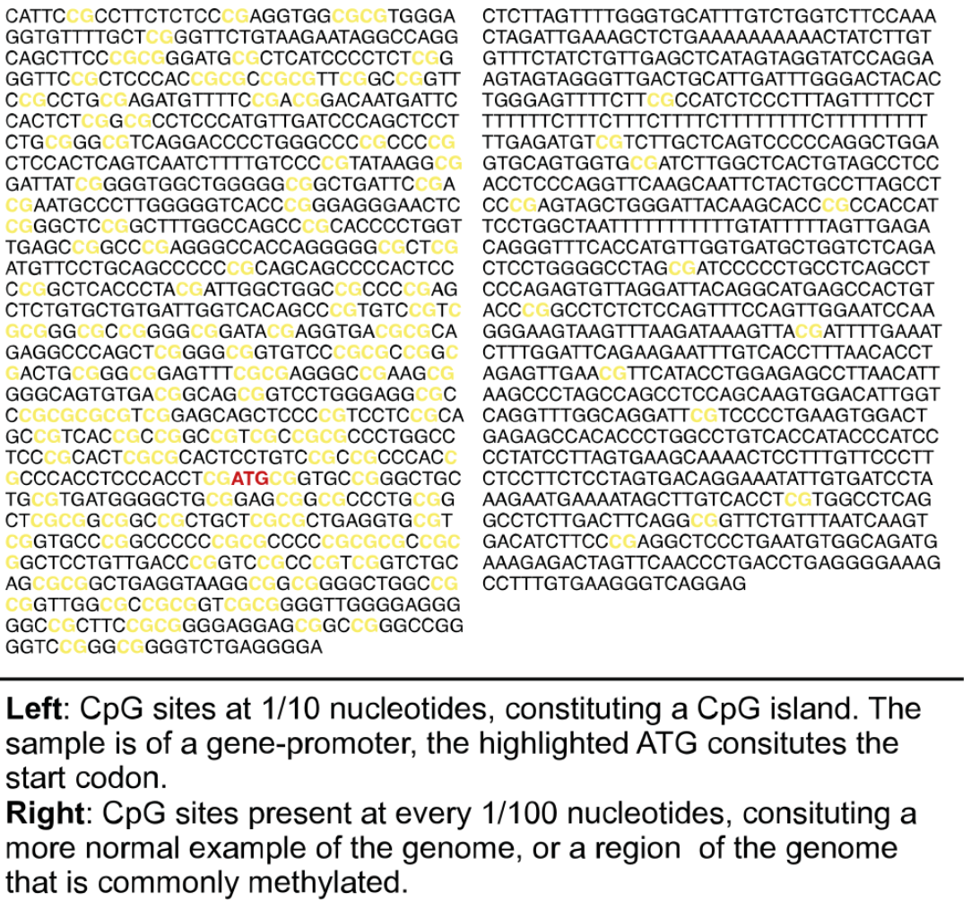
CpG Islands
CpG islands are regions of DNA where guanine nucleotides typically follow cytosines
Can be methylated to impact gene expression regulation
Many genes in mammalian genomes have CpG islands associated with the start of the gene
https://en.wikipedia.org/wiki/CpG_site

Slide 13
Using Markov Chains to Model CpG Islands
CpG+ Markov Chain Model
The previous state diagram example is a very simple example but what if we wanted to model biases in our transitions?
For example let’s say we are interested in modeling CpG islands
Our probabilities would change to assign higher probabilities to Cs and Gs versus As and Ts
0.18
0.120
0.18
A
T
0.25
0.36
0.38
0.17
0.27
0.08
0.13
0.19
0.27
C
G
0.16
0.37
0.38
0.45
0.05
0.05
0.25
β
0.45
Durbin et al., Biological Sequence Anslysis, 1998

Slide 14
Using Markov Chains to Model CpG Islands
CpG+ Markov Chain Model
Let’s try it out using a couple example sequences:
Seq 1: CGCG
P(CGCG) = p(C) X P(G|C) X P(C|G) X P(G|C)
= 0.45 X 0.27 X 0.38 X 0.27
= 0.0125
Seq 2: GAAC
P(GAAC) = p(G) X P(A|G) X P(A|A) X P(C|A)
= 0.45 X 0.16 X 0.18 X 0.27
= 0.00350
Based on our Markov Chain model Seq 1 is more likely to be part of a CpG island than Seq 2
Our Markov chain model fits Seq 1 better
0.18
0.120
0.18
A
T
0.25
0.36
0.38
0.17
0.27
0.08
0.13
0.19
0.27
C
G
0.16
0.37
0.38
0.45
0.05
0.05
0.25
β
0.45

Slide 15
Processing language with Markov Chains
Markov chains can be used to model many things, including language
For example, if we take the Dr. Seuss phrase “One fish two fish red fish blue fish”, we can treat each unique word as a state and then calculate transitions between each state based on their frequency of occurrence
For example, ‘one’, ‘two’, ‘red’, and ‘blue’ never transition to teach other, but ‘fish’ gets transitioned to and from quite a bit!

Slide 16
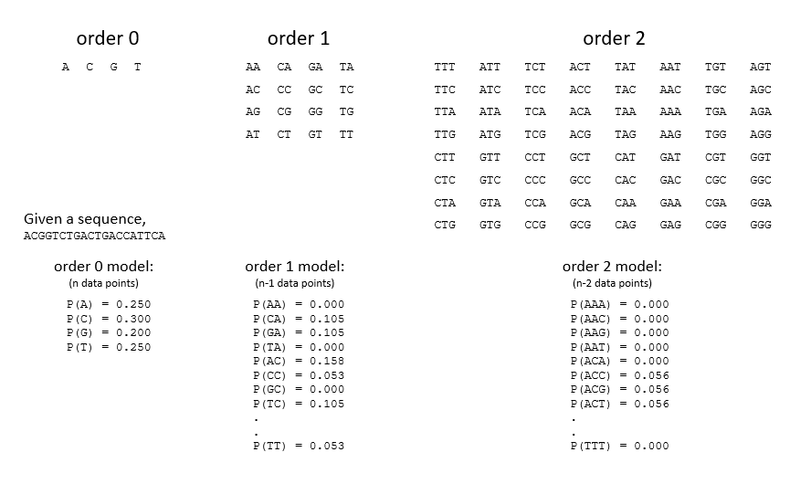
Higher orders of Markov chains
We can calculate transition probabilities in a number of ways, depending on how we describe our ‘previous state’
Sometimes the ‘previous state’ can actually be made up of multiple observations together.
In the case of DNA, a 1st order Markov model would use the previous base while a 2nd order model would use the previous 2 bases
For Dr. Seuss, substitute Nth words to define the state!

